Slide 1
Introduction to ETL (Extract, Transform, LOAD)

Slide 2
Overview
1. Intro to Data Warehousing
2. Into to ETL
3. ETL Architecture
4. Data Staging
5. Transformation Options
6. Fact and Dimension Tables
7. ETL vs ELT
8. Real-Time ETL Examples

Slide 3
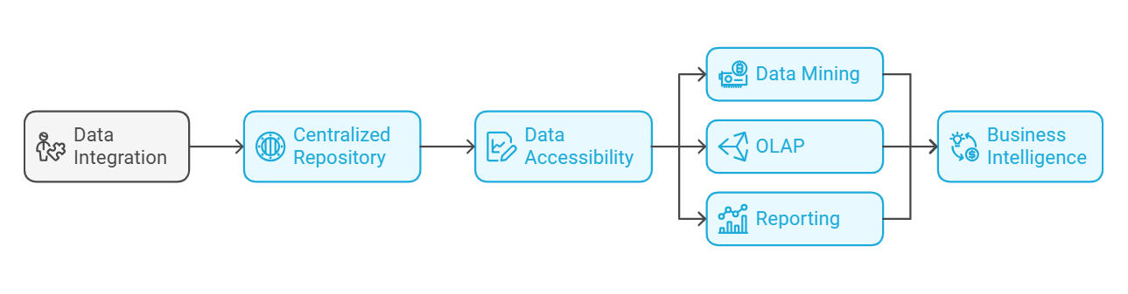
Introduction to data warehousing
A Data Warehousing system is a centralized repository that stores integrated data from multiple sources, making it accessible for analysis and reporting.
Data warehouses are designed to facilitate business intelligence activities, including data mining, online analytical processing (OLAP), and reporting.

Slide 4
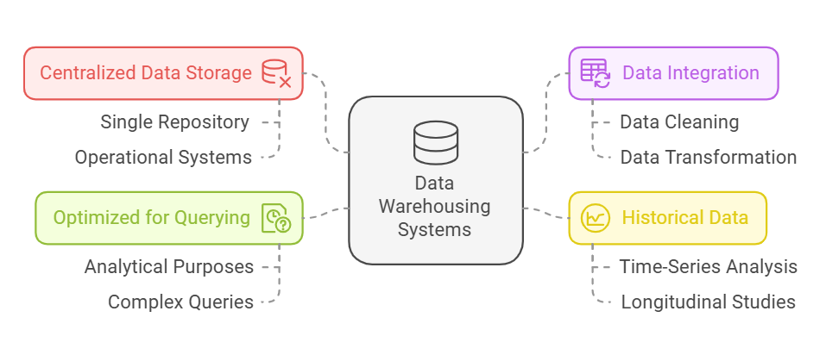
Features of data warehouse
Notes:
Centralized Data Storage: Data from various operational systems is consolidated into a single repository.
Data Integration: Data is cleaned, transformed, and integrated to ensure consistency and accuracy.
Historical Data: Data warehouses store historical data, allowing for trend analysis and reporting over time.
Optimized for Querying: Data warehouses are designed to handle complex queries efficiently, making them suitable for analytical purposes.

Slide 5
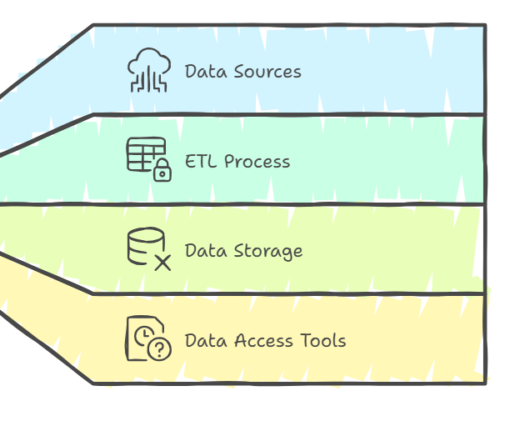
Introduction to ETL
ETL stands for Extract, Transform, Load, and it is a key process in data warehousing.
ETL involves extracting data from various source systems, transforming it into a format suitable for analysis, and loading it into a data warehouse or another data repository.
This process ensures that the data is accurate, consistent, and usable for business intelligence and decision-making.

Slide 6
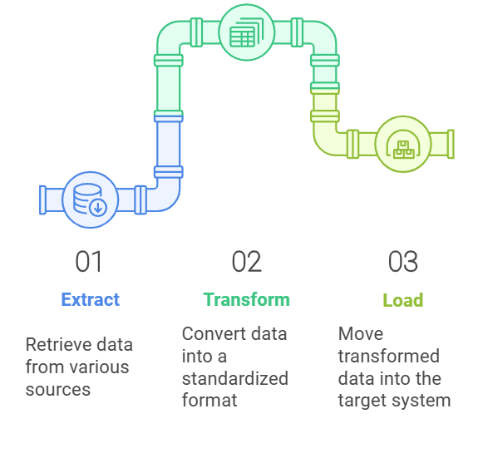
ETL Architecture
Extract:
Purpose: Retrieve data from different source systems, which may include databases, files, APIs, or cloud services.
Tools/Technologies: ETL tools like Talend, Informatica, or Apache Nifi.
Transform:
Purpose: Convert the extracted data into a clean, standardized format that aligns with the target schema in the data warehouse.
Common Transformations:
Data Cleaning, Data Integration, Data Aggregation, Data Enrichment, Data Formatting
Load:
Purpose: Move the transformed data into the target data warehouse or repository.

Slide 7
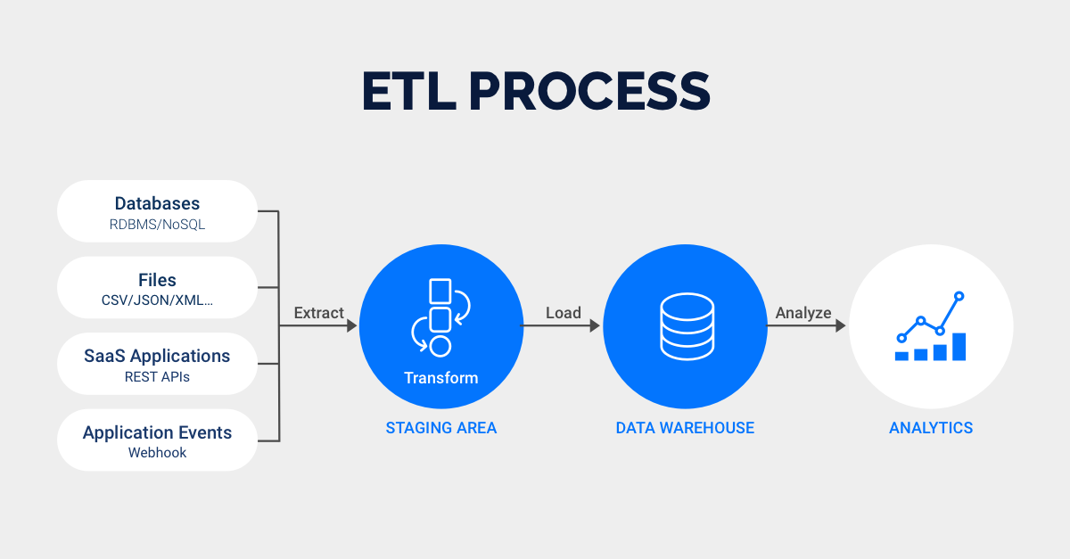
ETL Architecture
Notes:
1. The staging area in an ETL process plays a crucial role in ensuring the quality, integrity, and efficiency of data transformation and loading.
2. Data Validation and Cleansing: Raw data extracted from various sources can have inconsistencies, duplicates, or missing values. The staging area allows for data validation and cleansing before it is transformed and loaded into the target system, ensuring high-quality data.
Data Transformation: In the staging area, data can be transformed to match the format and structure required by the target system. This includes tasks like data type conversion, aggregation, and enrichment.
Isolation of Source Systems: By using a staging area, the impact on source systems is minimized. Data extraction can be done during off-peak hours, and any issues during transformation or loading won't affect the source systems.
Error Handling and Recovery: The staging area provides a buffer to handle errors and recover from issues that may arise during the ETL process. If there are problems during transformation or loading, data can be reprocessed from the staging area without having to re-extract it from the source.
Staging stuff:
Definition: The staging area is a temporary storage space used during the ETL (Extract, Transform, Load) process. It serves as an intermediate step where raw data is held before being transformed and loaded into the data warehouse.
2. Key Objectives:
Temporary Storage: Store raw data extracted from multiple sources.
Data Cleansing: Identify and correct errors, remove duplicates, and handle missing values.
Data Validation: Ensure data consistency and integrity by applying validation checks.
Data Transformation Preparation: Prepare data for transformation by standardizing formats and structures.
3. Importance of the Staging Area:
Data Quality: Cleansed and validated data ensures that only high-quality information is loaded into the data warehouse.
Performance Optimization: Separates the data extraction phase from transformation and loading, allowing for better performance tuning and resource allocation.
Error Handling: Provides a buffer to handle errors and anomalies, reducing the risk of propagating issues to the target system.
Scalability: Facilitates handling of large volumes of data and integration from multiple sources.
4. Key Activities in the Staging Area:
a. Data Extraction:
Extract data from various sources such as databases, flat files, APIs, and IoT devices.
Store the extracted data in the staging area for further processing.
b. Data Cleansing:
Duplicate Removal: Identify and eliminate duplicate records.
Missing Value Handling: Fill in missing values or mark them as unknown.
Error Correction: Correct known errors or anomalies in the data.
c. Data Validation:
Consistency Checks: Ensure data consistency across different sources.
Integrity Checks: Verify referential integrity between related tables.
Business Rule Validation: Apply business-specific rules to validate data.
d. Data Standardization:
Format Standardization: Convert data into consistent formats (e.g., date formats, measurement units).
Data Type Conversion: Change data types to match the target system requirements.
Generally staging is in on premise or cloud(Tools like bigQuery and Redshift have these)
Factors to Consider When Choosing a Staging Area:
Data Volume: The capacity to handle the volume of data being processed.
Performance: The speed and efficiency of data storage and retrieval operations.
Scalability: The ability to scale storage as data grows.
Cost: The cost-effectiveness of the storage solution.
Integration: Compatibility with existing ETL tools and infrastructure.
Security and Compliance: Ensuring data security and compliance with relevant regulations.
In summary, the staging area can be implemented using various storage solutions, including databases, cloud storage, on-premises storage, data warehousing services, and ETL platforms. The choice depends on factors such as data volume, performance requirements, scalability, cost, and integration needs.
Many modern ETL tools, including Informatica Intelligent Cloud Services (IICS), have built-in support for staging areas. This means that you do not necessarily need a separate tool for staging, as these ETL platforms provide the functionality to temporarily store, cleanse, validate, and prepare raw data before transformation and loading.

Slide 8
Transformation Options
Transformation Option | Description | Example
Data Cleaning | Remove duplicates | Removing duplicate customer records
Data Filtering | Row filtering | Selecting transactions above a certain amount
 | Column filtering | Keeping only relevant columns like "Name" and "Email"
Data Aggregation | Summarize data | Calculating total sales per month
Data Enrichment | Create calculated fields | Deriving "Profit Margin" from "Revenue" and "Cost"
Transformation Option | Description | Example
Data Transformation | Convert data types | Changing "Quantity" from text to integer
 | Manipulate strings | Extracting area code from phone numbers
 | Map data | Mapping source fields to target fields
Data Integration | Merge data | Combining customer data from multiple sources
Data Validation | Integrity checks | Ensuring foreign keys match between tables

Slide 9
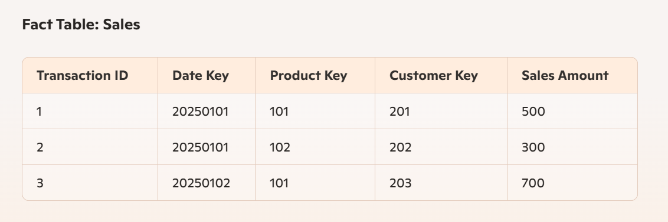
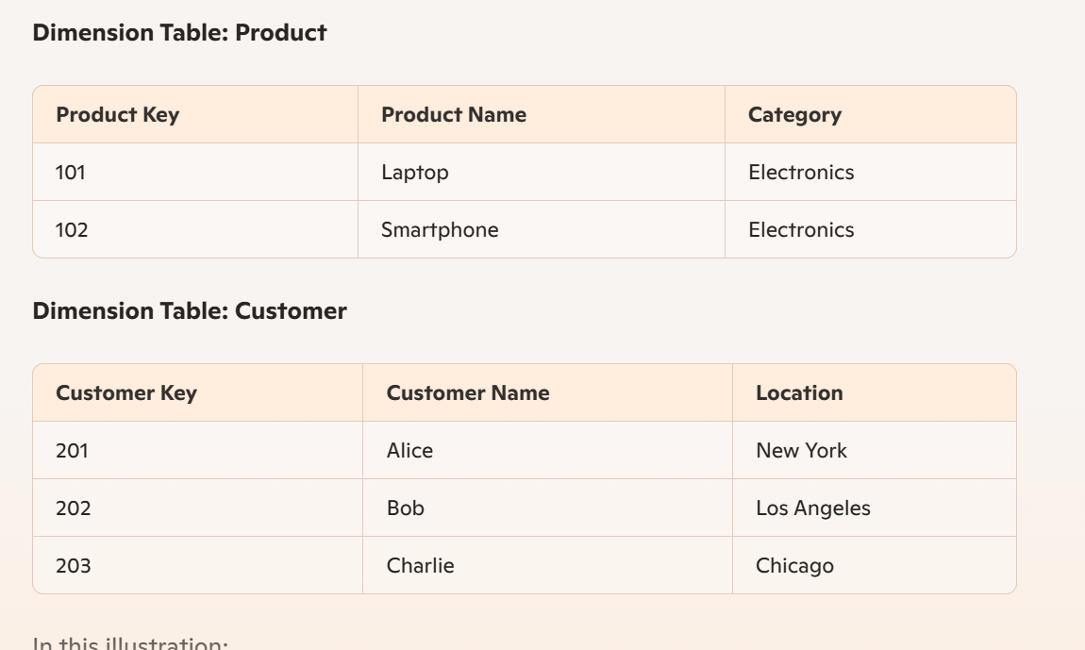
Fact and dimension tables
Fact Tables:
Store quantitative data for analysis, such as sales figures or transaction amounts.
Contain measurable metrics and keys to associated dimension tables.
High-volume tables that grow over time as new data is loaded.
Dimension Tables:
Store descriptive attributes related to the facts, such as product details or customer information.
Provide context to the facts, enabling detailed analysis and reporting.
Smaller in size compared to fact tables, with attributes that describe business entities.
Notes:
Effective transformations ensure that the data loaded into the data warehouse is clean, consistent, and ready for analysis
1. Extract:
Data is extracted from multiple sources such as POS (Point of Sale) systems, inventory databases, and customer relationship management (CRM) systems.
Example sources include Sales Transactions, Product Information, and Customer Data.
2. Transform:
Data Cleaning: Remove duplicates, handle missing values, and standardize formats.
Data Transformation: Convert raw data into a structured format, such as converting transaction timestamps to a standardized date format.
Transformation Example:
Sales Transactions: Convert transaction timestamps to Date Key, extract Product Key, Store Key, and Customer Key.
Product Information: Standardize product names and categories, generate unique Product Key.
Customer Data: Standardize customer names, addresses, and generate unique Customer Key.
3. Load:
Data is loaded into fact and dimension tables in the data warehouse.

Slide 10
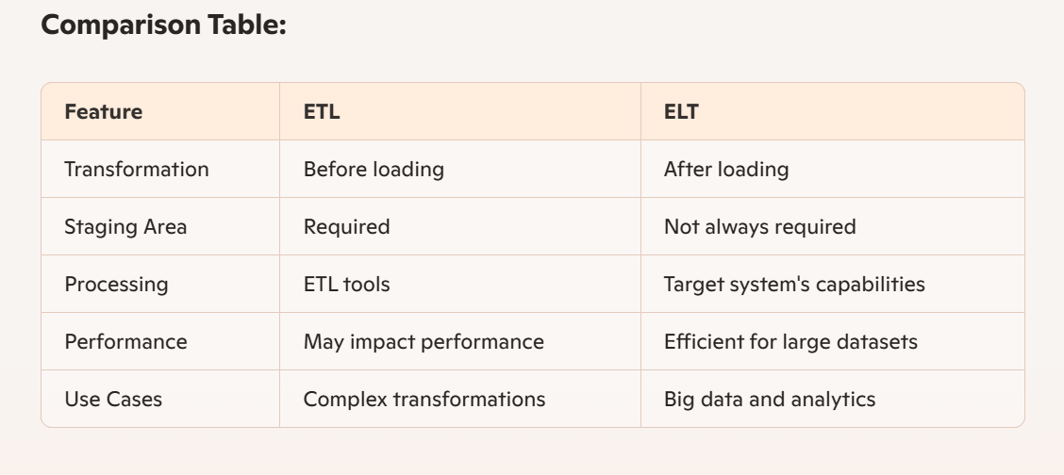
ETL vs ELT
Choosing Between ETL and ELT:
ETL: Best suited for environments where data transformations are complex and need to be done before loading the data into the target system. Ideal when source systems cannot handle large-scale data processing.
ELT: Best suited for environments with large volumes of data where the target system has robust processing capabilities. Ideal for big data scenarios, real-time analytics, and when the target system can efficiently handle data transformation.

Slide 11
Real-time examples
Scenario 1: The bank needs to generate financial reports by consolidating transactional data from multiple systems (ATMs, online banking, branches).
Scenario 2: The bank needs to perform analytics on financial data to gain insights and generate reports.
Notes:
Real-World Applications:
ETL: Ideal for traditional data warehousing scenarios where complex transformations are needed before loading, and the source systems cannot handle large-scale data processing.
ELT: Suitable for big data and real-time analytics scenarios where the target system (data lake or cloud-based data warehouse) can efficiently handle large-scale data processing and transformations.
Exactly! The choice between ETL and ELT largely depends on the specific infrastructure, requirements, and preferences of the client. Both approaches have their own advantages and are suited for different scenarios. Here's a summary:
Factors Influencing the Choice:
Infrastructure:
ETL: Suitable for traditional on-premises data warehouses or systems where transformations need to be done before loading.
ELT: Ideal for modern cloud-based data warehouses or data lakes with robust processing capabilities.
Data Volume and Complexity:
ETL: Best for environments where data transformations are complex and need to be done before loading.
ELT: Suitable for handling large volumes of data, leveraging the processing power of the target system.
Performance Requirements:
ETL: May impact performance if transformations are resource-intensive. Optimized for environments where data quality is paramount before loading.
ELT: Efficient for real-time analytics and big data scenarios, as the target system can handle large-scale transformations.
Scalability and Flexibility:
ETL: Provides a structured approach with dedicated staging areas for data cleansing and validation.
ELT: Offers flexibility and scalability by leveraging cloud-based infrastructure and services.
Client Preferences:
ETL: Preferred by clients who need strict control over data transformations before loading.
ELT: Favored by clients who want to take advantage of cloud-based processing and real-time analytics capabilities.
Conclusion:
ETL and ELT are both valid approaches, and the choice between them depends on the specific needs and capabilities of the client’s infrastructure.
By evaluating the factors mentioned above, organizations can make an informed decision on whether to use ETL or ELT for their data integration and analytical requirements.
Informatica Intelligent Cloud Services (IICS) for ELT:
IICS is a cloud-based data integration platform that supports ELT processes. It allows organizations to leverage the powerful processing capabilities of cloud-based data warehouses or data lakes for transformations.
ELT Process with IICS:
Extract: Data is extracted from various source systems.
Load: Raw data is loaded directly into the cloud-based data warehouse or data lake.
Transform: Data transformations are performed within the target system using its processing power.
This approach allows for efficient handling of large data volumes and real-time analytics.
Informatica PowerCenter for ETL:
PowerCenter is a widely used ETL tool that provides robust data integration capabilities for on-premises environments.
ETL Process with PowerCenter:
Extract: Data is extracted from various source systems.
Transform: Data transformations are performed in a staging area within PowerCenter to ensure data quality and consistency.
Load: Transformed data is loaded into the target system, such as a data warehouse.
This approach is suitable for traditional data warehousing scenarios where complex transformations are needed before loading.

Slide 12
Thank you!!

